Slide 1
K

Slide 2

Table fan

Slide 3
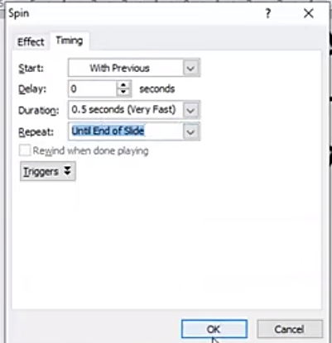

Slide 4

aeroplane

Slide 5

Boat Animation

Slide 6

Wind mill animation

Slide 7
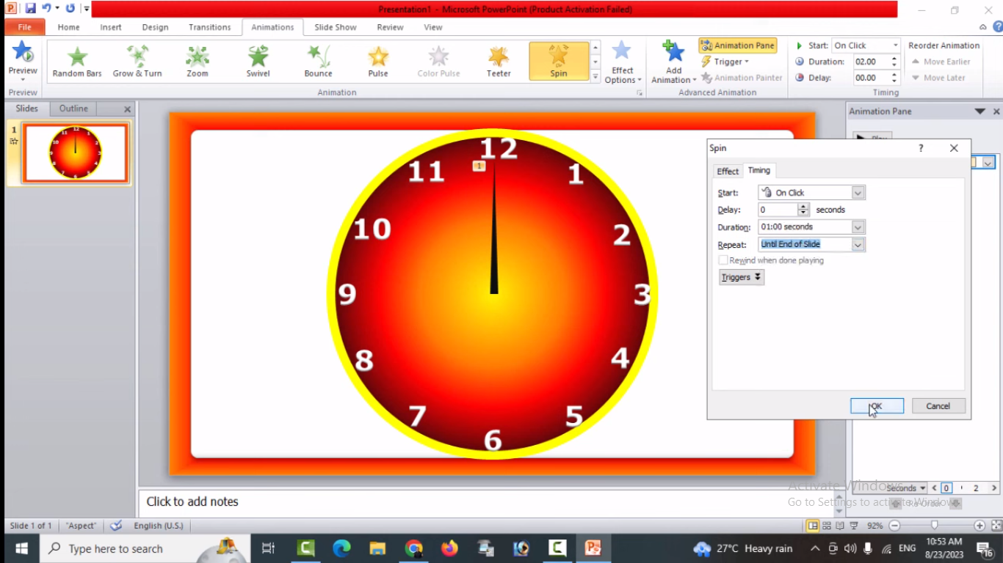
Clock Animation
12
11
1
10
2
9
3
8
4
7
5
6

Slide 8



RUNNING BOY

Slide 10

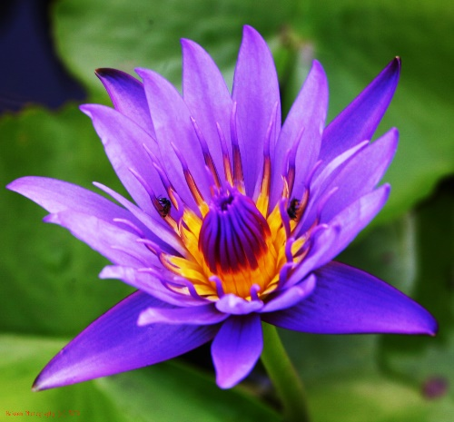


Slide 13
M
T
A
P
I
S
V
B
O
I
C
N
H
k
U
L
E

Slide 14
I Love My India

